Slide 1
Work Progress
27.11.17

Slide 2



Previous Meeting
Room air velocity
Include schematic about situation before/without ceiling & clarify test numbers of each configuration
Re-do smoke test + schematics w/ closed curtain & Open ceiling to validate fan speed setting
Two tests to confirm (Temp+Humidity AND Smoke) tests
25% fan speed – closed curtain – open ceiling
25% fan speed – closed curtain – closed ceiling
Low-charge system
Flush is definitely a must. Whatever it takes. → Remove 1 Condensor?
Data processing
Small error to fix w/ time stamps
EES model
Look at literature sent
SB to send A/C unit EES model from JL/VT
http://pdsim.sourceforge.net/index.html or other HP simulation model

Slide 3
Last week:
Used the drive to run the compressor with a higher frequency to ensure better oil return → No effect
Removed 300g R407c from IDC500 /w Kristian
Installed new compressor in drive test rig, refilled 460g R410a
/w Romain
25pct fan power tests (open ceiling vs closed ceiling)
Further work on Pythonscript
All version issues solved
Now able to read and resample data
Several plots

Slide 4
Previous Testing (30pct)

Slide 5
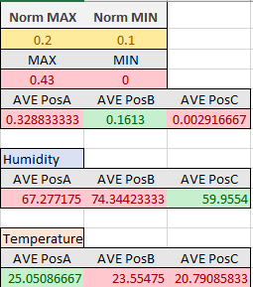
25pct fan power with Open Ceiling

Slide 6
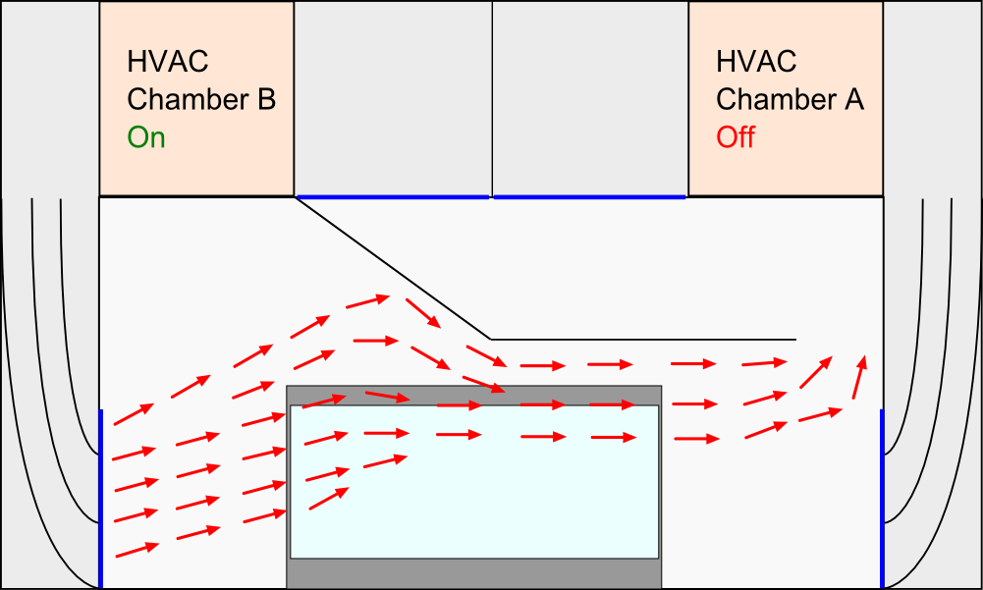
25pct fan power with Open Ceiling
29°C
17°C
29°C

Slide 7
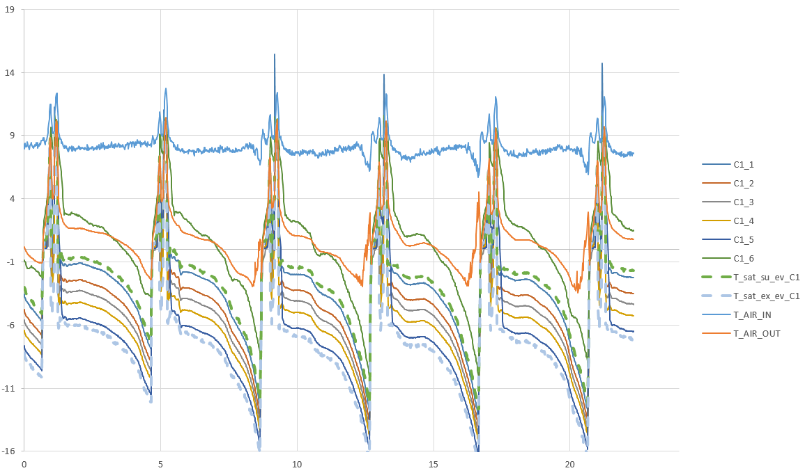
(49)Evaporator temperature with open ceiling

Slide 8
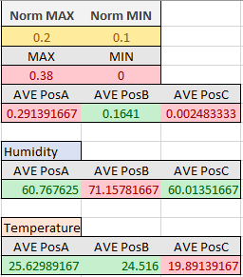
25pct fan power with closed Ceiling

Slide 9
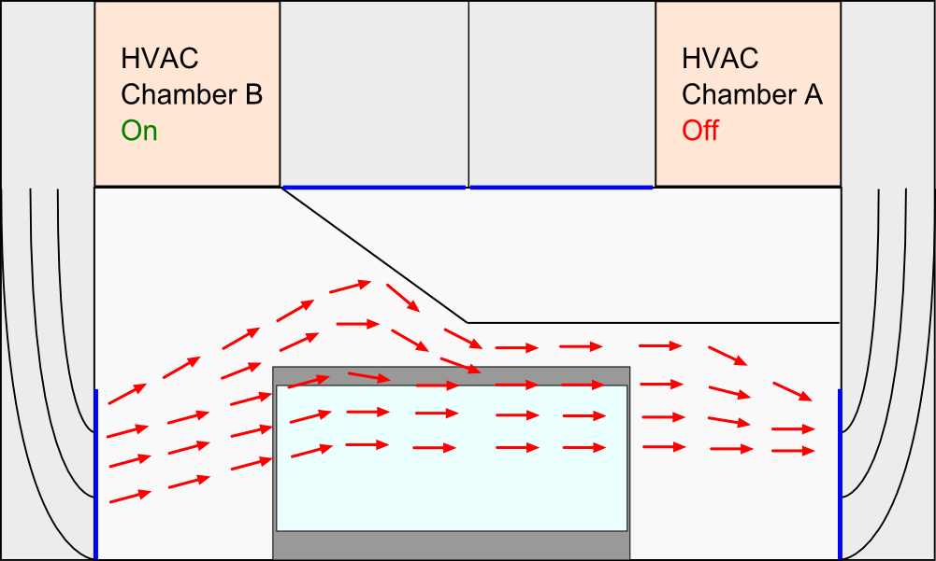
25pct fan power with closed Ceiling
29°C
17°C
29°C

Slide 10
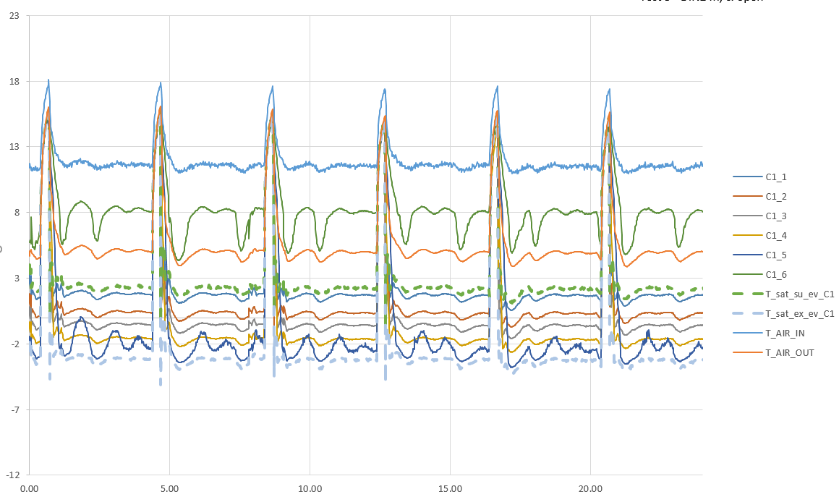
(CC)Evaporator temperature with closed ceiling

Slide 11
Conclusion
Closed Ceiling
More laminar air flow
Air velocity is a little lower
Chamber regulates slower / more unstable
Evaporating temperature isn’t falling → Higher Product temperature
Open Ceiling
Chamber regulates better
Product temperature is lower than previous tests
Higher turbulence
Continue testing with Open Ceiling and 25 pct fan power

Slide 12
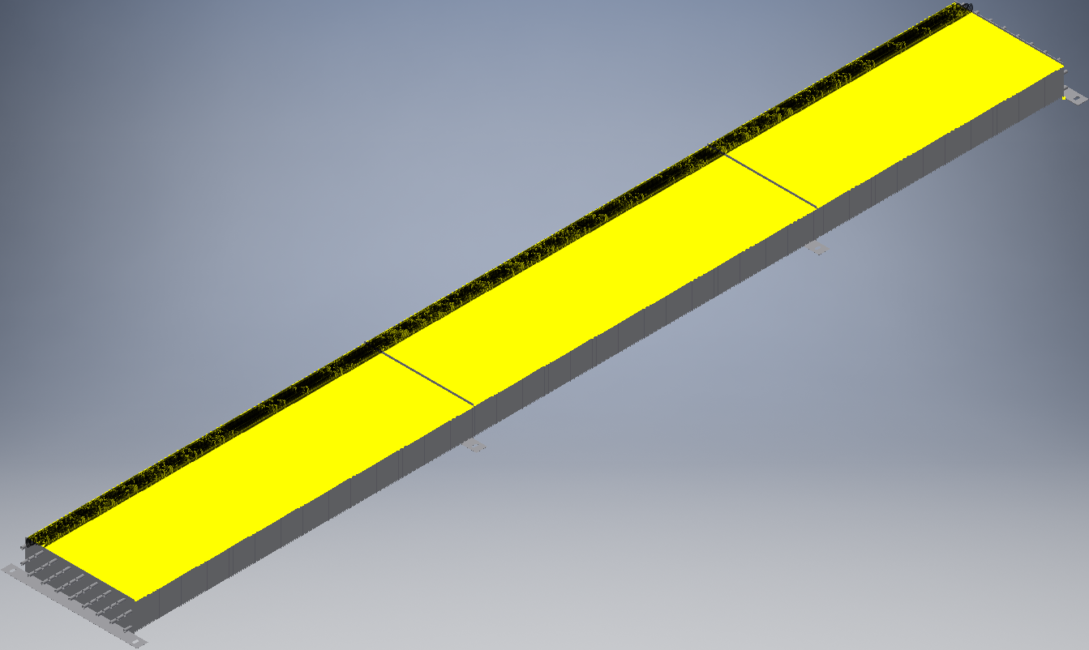
CAD-model of new evaporator

Slide 13
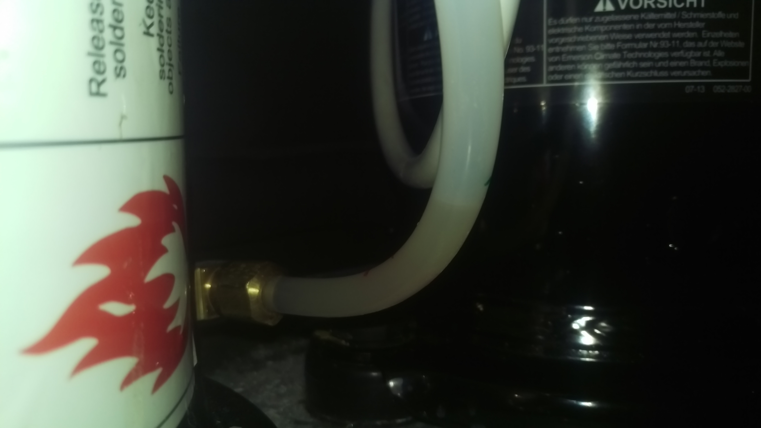
Oil levels
Comp OFF
Delivery Oil Lvl
Comp ON

Slide 14
Power: 3MAF vs HATCOL
Test # | Spec | Condensing Temp | Product Temp [°C] |  |  |  | COP compr | Qevap Qcond hevap in + Select massflow | Pcp,meas | Qevap,select0K | Pcp,sel | Qcond | xcd,out (mselect) | xcd,out (mselect) | xcd,out (mselect)
35.00 | t_75 30pct OC | 35.00 | 5.35 | 10.54 | 0.98 | 5.34 | 2.33 | 5.68 | 2.44 | 7.01 | 2.31 | 7.84 | 0.20 | 0.10 | 0.13
48.00 | t_75 27pct OC | 35.00 | 6.23 | 11.43 | 1.97 | 6.02 | 2.27 | 5.76 | 2.54 | 8.07 | 2.26 | 8.12 | 0.27 | 0.21 | 0.25
AVG MAX MIN MED

Slide 15
To do:

